Slide 1


Slide 2

Major Project – I (01CE0716)
Review 1 (29/07/2024)
WEATHER FORECAST APP
Team ID: 7CE_MP_042
Team Member 1: TEJ DEKIWADIYA (92100103011) (TC2)
Team Member 2: KRUTI VADALIYA (92100103349) (TC4)
Team Member 3: MOHIT KARIA (92100103401 ) (TC4)
Guided By
Internal Guide Name: Prof. Harsh Nagar
Department of Computer Engineering, Faculty of Technology

Slide 3
Outline
Introduction
Abstract
System Analysis
System Design
Project Flow Chart
Expected Outcomes
References

Slide 4
Introduction to Project and Project Management
1.1 Project Summary:
The Weather Forecast App is a dynamic web application built using the MERN stack (MongoDB, Express.js, React.js, and Node.js).
It allows users to check real-time weather conditions for various locations worldwide. The app fetches weather data from an external API and displays detailed forecasts, including temperature, humidity, and wind speed.
Users can search for specific cities, view current weather conditions, and get updates on upcoming weather trends.
The responsive design ensures a seamless user experience across devices. MongoDB stores user preferences and search history, while Express.js and Node.js handle server-side operations. React.js powers the interactive front-end, providing a smooth and intuitive interface.
1.2 Purpose:
A weather forecast app is designed to provide users with up-to-date information about the weather conditions in their area or any location they choose. The main purposes of a weather forecast app include:
Real-Time Weather Updates: Offering current weather conditions, such as temperature, humidity, wind speed, and precipitation, so users can plan their activities accordingly.

Slide 5
Introduction to Project and Project Management
Forecast Predictions: Providing short-term (hourly) and long-term (daily or weekly) weather forecasts to help users prepare for upcoming weather changes.
Alerts and Notifications: Sending notifications about severe weather conditions, such as storms, heatwaves, or heavy rainfall, to keep users informed and safe.
Travel and Outdoor Planning: Assisting users in planning trips, outdoor activities, or daily commutes by providing information about weather conditions that may affect their plans.
Customizable Locations: Allowing users to check the weather in multiple locations, which is useful for travelers, or those with family or friends in different regions.
Weather Insights: Offering additional data such as air quality, UV index, or pollen count, which can be crucial for health-conscious users or those with specific needs.
1.3 Objective:
Provide accurate, real-time weather updates.
Offer short-term and long-term weather forecasts.
Alert users to severe weather conditions for safety.
Assist in planning daily activities and travel.
Enhance user experience with a simple, intuitive interface.
Allow customization of locations and alerts for personalized use.

Slide 6
Introduction to Project and Project Management
1.4 Scope:
What It Can Do
Show current weather conditions like temperature and rain.
Give weather predictions for the next hours, days, or week.
Send alerts about bad weather, like storms or heatwaves.
Let you check the weather in different places around the world.
Provide extra info like air quality or UV levels.
What It Can’t Do:
Always be 100% accurate, as weather can be unpredictable.
Change or control the weather.
Guarantee precise forecasts for longer than a week.
Make decisions for you—it's up to you to use the information wisely.

Slide 7
Introduction to Project and Project Management
1.5 Technology:
Frontend:
React.js: Builds dynamic, interactive weather apps.
Tailwind CSS: Helps create clean, responsive designs quickly.
APIs:
OpenWeatherMap: Provides real-time weather data.
React Leaflet: Displays weather data on interactive maps.
Backend:
Node.js + Express.js: Manages server-side logic and handles data efficiently.
Authentication:
JWT: Secures user login with tokens.
bcrypt: Encrypts passwords for safe storage.
Database:
MongoDB: Stores and manages large amounts of data flexibly.

Slide 8
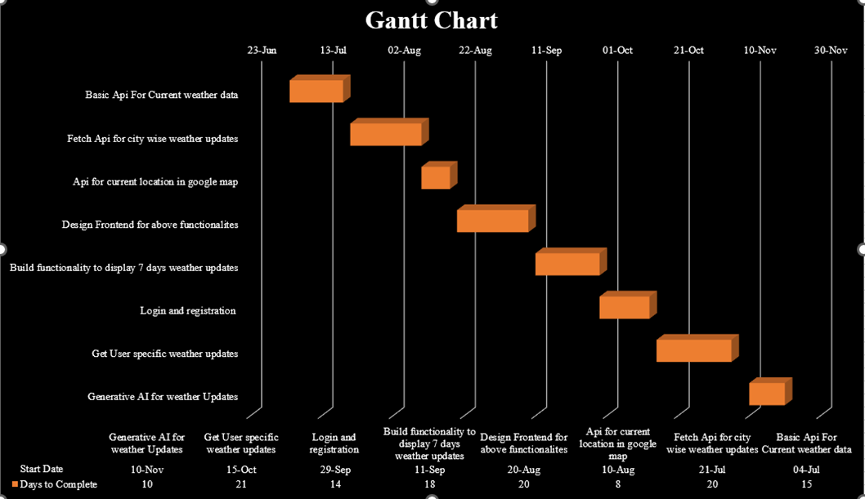
Introduction to Project and Project Management
1.6 Project Gantt Chart:

Slide 9
System Analysis
2.1 Study of Current System:
Weather Data Collection:
Weather data is gathered from sources like satellites and weather stations, including temperature, rain, wind, and more.
Data Processing:
This data is analyzed using special models to predict future weather.
API Services:
Services like OpenWeatherMap provide this processed weather data through APIs, which apps use to get weather information.
User Interaction:
The app uses this data to show users current weather, forecasts, and maps, often based on their location.
Limitations:
Accuracy: Forecasts can be inaccurate, especially long-term.
Customization: Some apps may not offer advanced features for personalized alerts.
Data Overload: Too much information can be overwhelming if not presented simply.

Slide 10
System Analysis
2.2 Problem and Weaknesses of Current System:
1. Accuracy Issues:
- Inaccurate forecasts, especially for long-term predictions or rapidly changing conditions.
2. Limited Customization:
- Lack of personalized alerts and customizable display options.
3. Data Overload:
- Excessive information without clear organization, leading to user confusion.
4. Real-Time Updates:
- Delays in updating weather data, resulting in outdated information.
5. User Interface:
- Non-intuitive design that hampers navigation and data interpretation.
6. Integration Issues:
- Limited integration with other apps and systems, reducing overall functionality.

Slide 11
System Analysis
2.3 System Feasibility:
2.3.1 Contribution to Objectives:
Enhances User Engagement: Provides timely weather info.
Increases Accessibility: Easy access to weather data.
Supports Decision-Making: Helps users make informed choices.
2.3.2 Technology, Cost, and Schedule:
Technology: Current tech stack (React.js, Node.js) is suitable and widely used.
Cost: Affordable with free or low-cost tools and APIs.
Schedule: Feasible within standard development timelines.
2.3.3 Integration with Existing Systems:
APIs: Easy integration with external APIs.
Authentication: Compatible with existing auth systems.
Database: MongoDB integrates well with other databases.
UI: Can work with other frontend tools if needed

Slide 12
System Analysis
1. System Overview
The Weather Forecast Project aims to provide users with accurate and personalized weather information. The system includes user authentication, real-time weather data, a 5-day forecast, geographical location mapping, and generative AI for future weather predictions with recommendations and precautions.
2. System Architecture
Frontend: React.js & Tailwind for styling.
Backend: Node.js with Express.js for server-side logic.
Database: MongoDB for database management.
APIs: OpenWeatherMap API for weather data, Integrate React Leaflet Map Component use to show current location, Custom AI model for future weather predictions
3. Functional Requirements
User Authentication: Registration/Login Pages.
Weather Features: Display the current weather based on the user's city. 5-Day Forecast- Provide a 5-day weather forecast for the user's city. Integrate React Leaflet Map Component use to show current location.
Generative AI Predictions- Allow users to input any future date to get weather predictions, recommendations, and precautions.

Slide 13
System Analysis
4. System Components:
Frontend:-
Login/Registration Pages:
- Form validation
- JWT authentication
Dashboard:
- Display current weather based on user’s city
- Show 5-day weather forecast
- Integrate React Leaflet Map Component use to show current location
- Input for future date to get AI-generated weather predictions
Database:-
User Collection:
- Stores user details, hashed passwords, and city
Weather Data Collection:
- Cache recent weather data for performance
Backend:-
User Management:
- RESTful API for registration and login
- Secure password storage with bcrypt
- JWT for session management

Slide 14
System Analysis
Weather Data Fetching:
- Fetch current weather and 5-day forecast using OpenWeatherMap API
- Cache data to minimize API calls
Geolocation Service:
- Integrate React Leaflet Map Component use to show current location on a map with weather condition
Generative AI Integration:
- Develop or integrate an AI model to predict future weather
- Provide recommendations and precautions based on AI predictions
5. Future Enhancements:
Add user notifications for severe weather alerts.
Implement social sharing features for users to share weather information.

Slide 15
System Design
3.1 System Design & Methodology
Frontend:
React.js: Manages the user interface, displaying weather data dynamically and interactively.
Tailwind CSS: Styles the UI for a clean, responsive design.
Backend:
Node.js + Express.js: Handles server-side logic, processes API requests, and manages data flow between the frontend and the database.
Database:
MongoDB: Stores user data, preferences, and historical weather data.
APIs:
OpenWeatherMap: Provides current weather data and forecasts.
React Leaflet Map Component: Integrates interactive maps to visualize weather information.
Components:
User Interface: Displays current weather, forecasts, and interactive maps. Users can customize their view and set alerts.
Authentication: Uses JWT for secure user login and bcrypt for password encryption.
Data Processing: Fetches weather data from APIs, processes it, and updates the UI in real-time.

Slide 16
System Design
Methodology
1. Requirement Analysis:
- Identify core features.
2. Design Phase:
- Create UI/UX designs and prototypes.
- Define app architecture and data flow.
3. Implementation:
- Build frontend with React.js and Tailwind CSS.
- Set up backend with Node.js and Express.js.
- Integrate APIs (OpenWeatherMap, React Leaflet).
4. Testing:
- Perform unit, integration, and user testing.
5. Deployment:
- Host on AWS, Heroku, or Vercel.
6. Maintenance:
- Regular updates and ongoing support.

Slide 17
System Design
3.2 ER Diagram
+-----------------+ +--------------------+ +-----------------+
| User | | WeatherData | | Feedback |
+-----------------+ +--------------------+ +-----------------+
| UserID (PK) |<--------------> | WeatherDataID (PK) |<--------------> | FeedbackID (PK) |
| Username | | Location | | UserID (FK) |
| Email | | Temperature | | WeatherDataID (FK) |
| Password | | Humidity | | Comment |
| ProfilePicture | | WindSpeed | | Rating |
| Preferences | | WeatherCondition | | CreatedAt |
| CreatedAt | | RecordedAt | +-----------------+
| UpdatedAt | | Forecast |
+-----------------+ +--------------------+

Slide 18
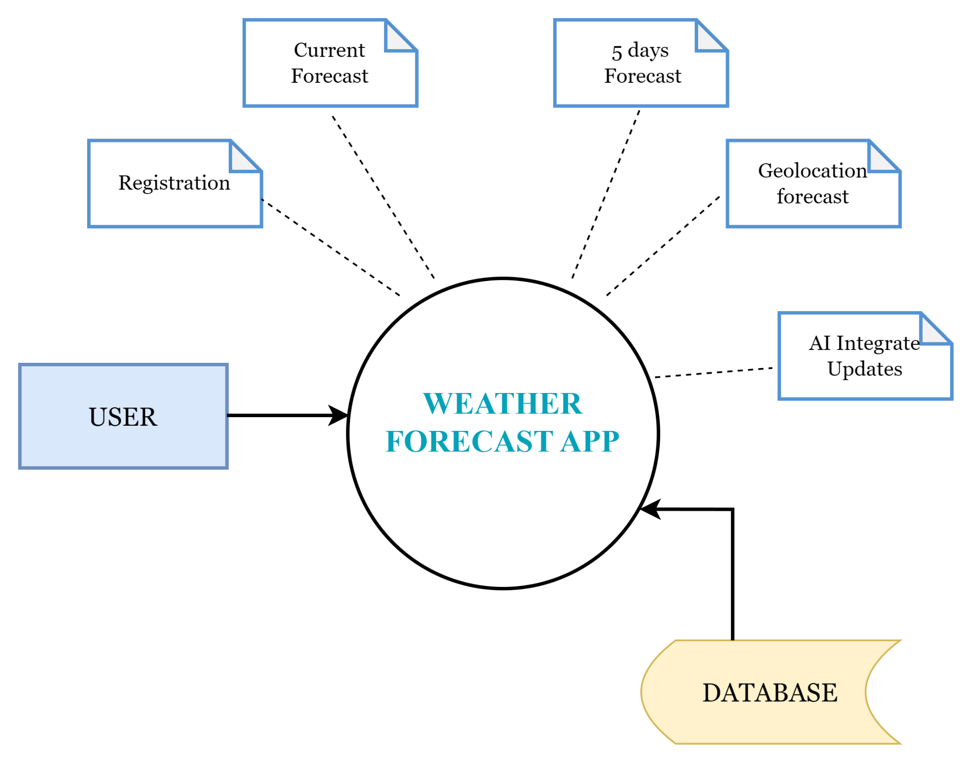
System Design
3.2 Data Flow Diagram(Level 0):

Slide 19
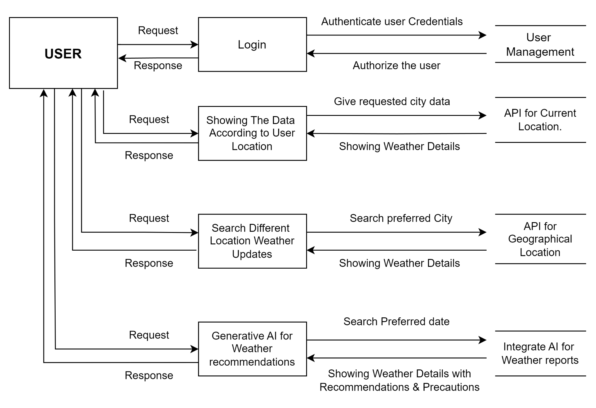
System Design
3.2 Data Flow Diagram(Level 1):

Slide 20
System Design
Architecture: The application employs a client-server architecture. The backend is built using robust server-side technologies (e.g., Node.js) to handle data processing and API requests. The frontend uses responsive design principles, utilizing HTML, CSS, and JavaScript frameworks like React.js.
Data Sources: The application integrates with third-party weather APIs (e.g., OpenWeatherMap, WeatherStack) to fetch real-time weather data. It uses geolocation services to provide localized weather updates.
Database: A database system (e.g., MongoDB) stores user preferences, historical weather data, and other relevant information.
Security Measures: The system implements HTTP for data transmission, user authentication, and encryption to the data.
Frontend Development: The user interface is developed using modern web technologies to ensure a seamless user experience across devices.
Backend Development: The server-side logic handles API requests, data processing, and communication with the database.
Maintenance and Updates: The system includes mechanisms for regular updates and maintenance to incorporate new features, improve performance, and address any security vulnerabilities

Slide 21
ER Diagrams
+-----------------+ +--------------------+ +-----------------+
| User | | WeatherData | | Feedback |
+-----------------+ +--------------------+ +-----------------+
| UserID (PK) |<--------------> | WeatherDataID (PK) |<--------------> | FeedbackID (PK) |
| Username | | Location | | UserID (FK) |
| Email | | Temperature | | WeatherDataID (FK) |
| Password | | Humidity | | Comment |
| ProfilePicture | | WindSpeed | | Rating |
| Preferences | | WeatherCondition | | CreatedAt |
| CreatedAt | | RecordedAt | +-----------------+
| UpdatedAt | | Forecast |
+-----------------+ +--------------------+

Slide 22
Proposed Solution
1. System Overview
The Weather Forecast Project aims to provide users with accurate and personalized weather information. The system includes user authentication, real-time weather data, a 5-day forecast, geographical location mapping, and generative AI for future weather predictions with recommendations and precautions.
2. System Architecture
Frontend: React.js & Tailwind for styling.
Backend: Node.js with Express.js for server-side logic.
Database: MongoDB for database management.
APIs: OpenWeatherMap API for weather data, Integrate React Leaflet Map Component use to show current location, Custom AI model for future weather predictions
3. Functional Requirements
User Authentication: Registration/Login Pages.
Weather Features: Display the current weather based on the user's city. 5-Day Forecast- Provide a 5-day weather forecast for the user's city. Integrate React Leaflet Map Component use to show current location.
Generative AI Predictions- Allow users to input any future date to get weather predictions, recommendations, and precautions.

Slide 23
Proposed Solution
4. System Components
Frontend:-
Login/Registration Pages:
- Form validation
- JWT authentication
Dashboard:
- Display current weather based on user’s city
- Show 5-day weather forecast
- Integrate React Leaflet Map Component use to show current location
- Input for future date to get AI-generated weather predictions
Database:-
User Collection:
- Stores user details, hashed passwords, and city
Weather Data Collection:
- Cache recent weather data for performance

Slide 24
Proposed Solution
Backend:-
User Management:
- RESTful API for registration and login
- Secure password storage with bcrypt
- JWT for session management
Weather Data Fetching:
- Fetch current weather and 5-day forecast using OpenWeatherMap API
- Cache data to minimize API calls
Geolocation Service:
- Integrate React Leaflet Map Component use to show current location on a map with weather condition
Generative AI Integration:
- Develop or integrate an AI model to predict future weather
- Provide recommendations and precautions based on AI predictions
5. Future Enhancements
Add user notifications for severe weather alerts
Implement social sharing features for users to share weather information

Slide 25
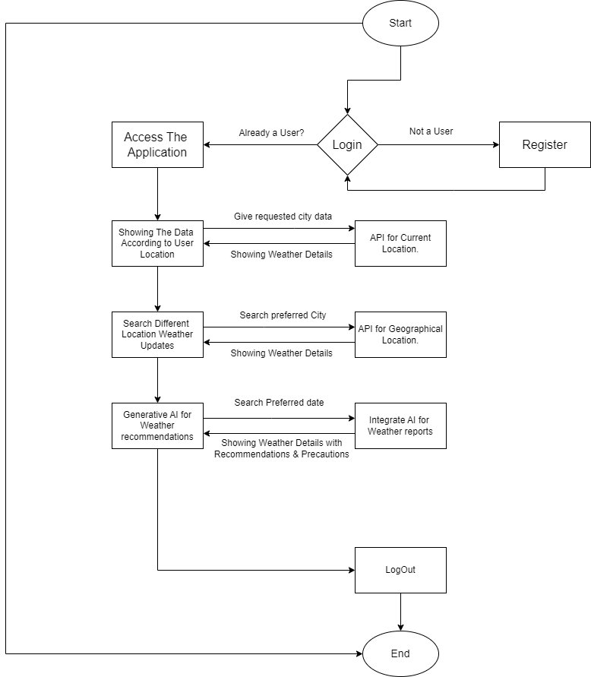
Flow Chart

Slide 26
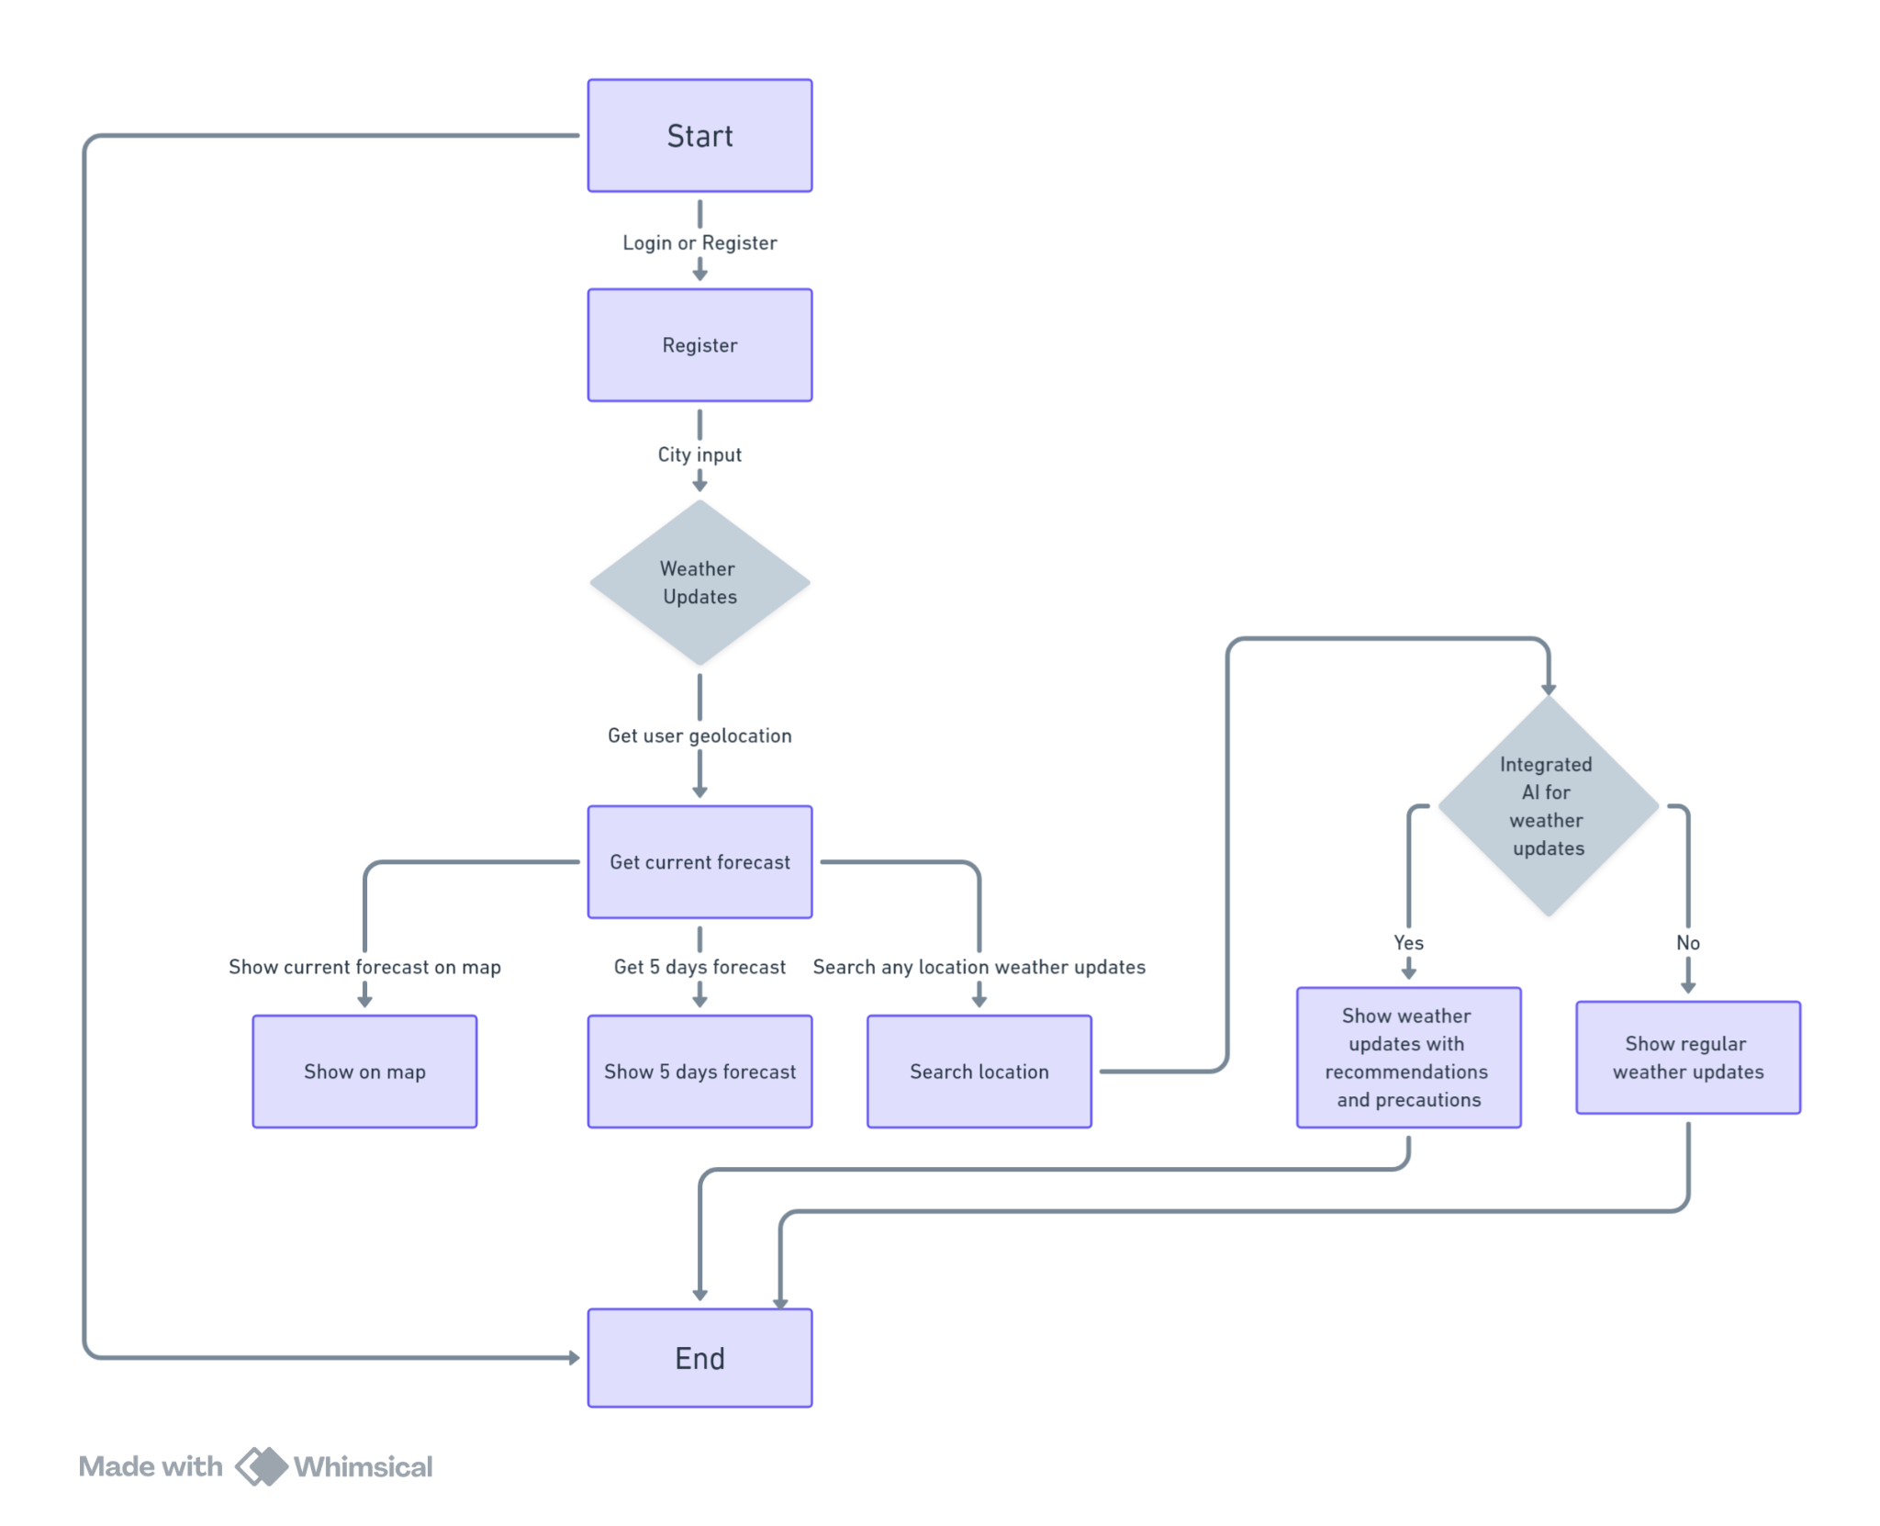
Flow Chart

Slide 27
Tools & Technologies To Be Used
Frontend:- React.js, Tailwind
APIs:- OpenWeatherMap, React Leaflet Map Component
Backend:- Node.js, Express.js
Authentication:- JWT, bcrypt
Database:- MongoDB

Slide 28
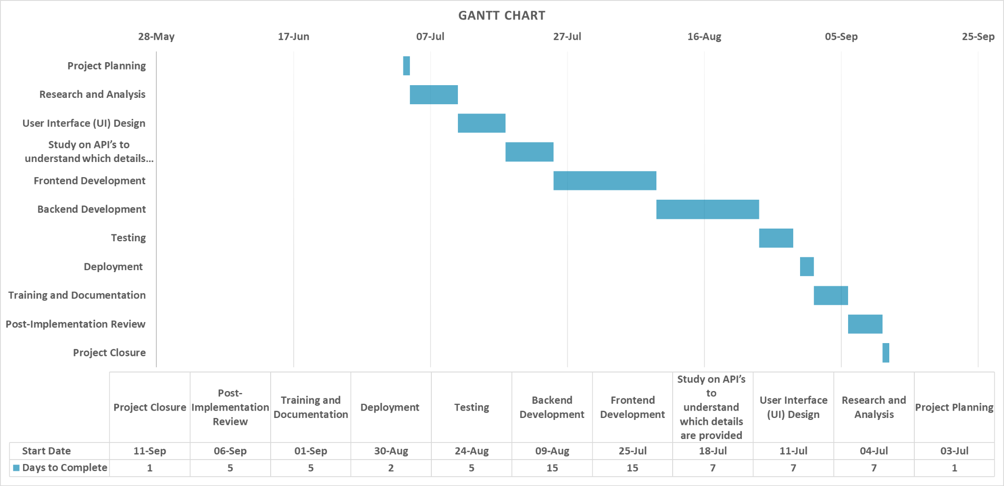
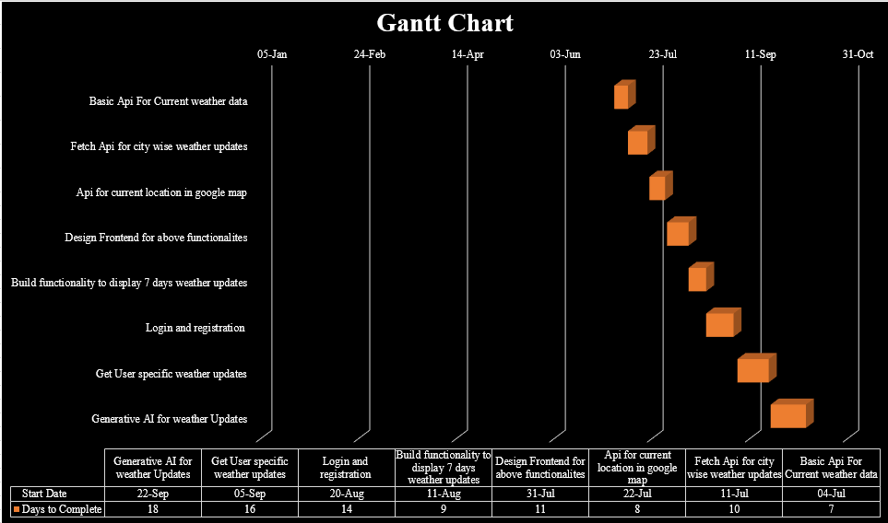
Gantt Chart

Slide 29
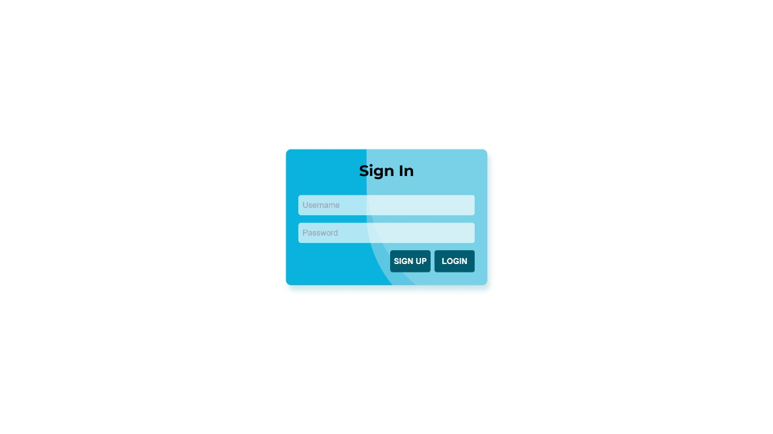
Expected Outcomes
Login page

Slide 30

Expected Outcomes
Register Page

Slide 31
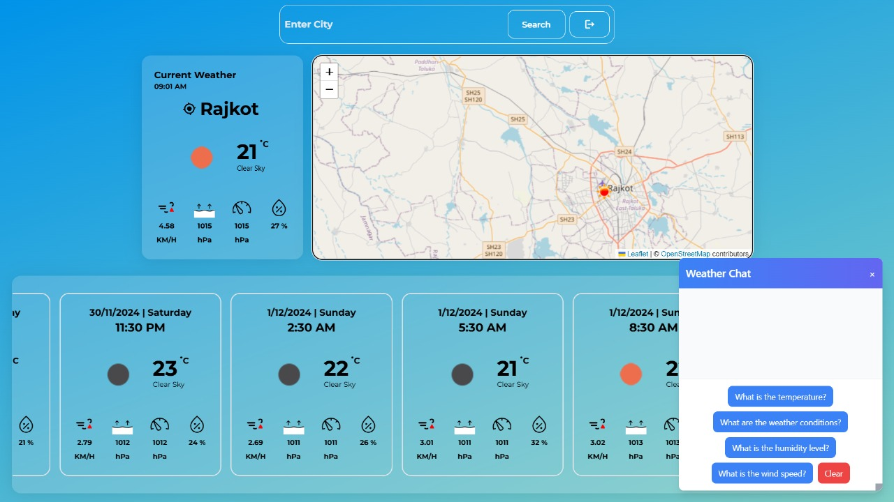
Expected Outcomes
Showing Current Weather

Slide 32
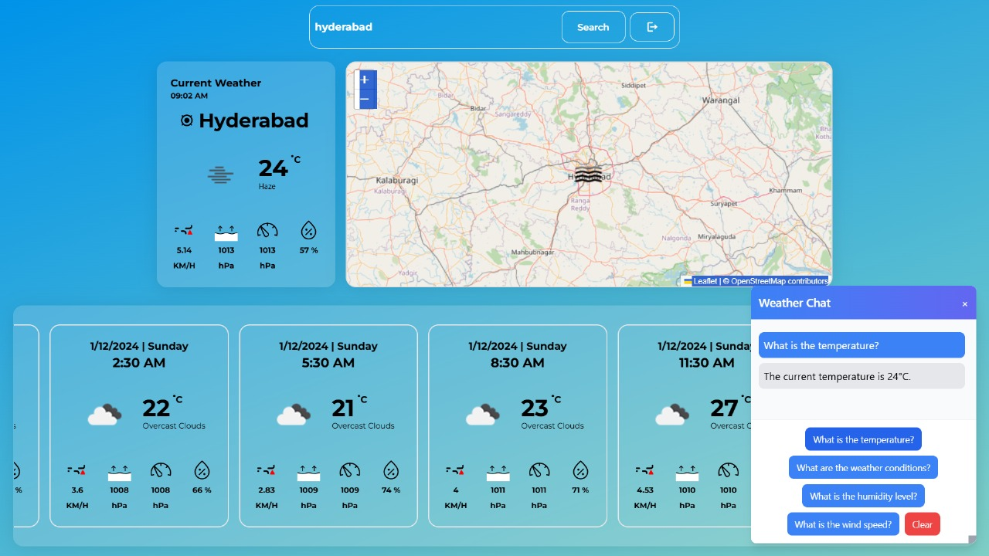
Expected Outcomes
Search Functionality

Slide 33
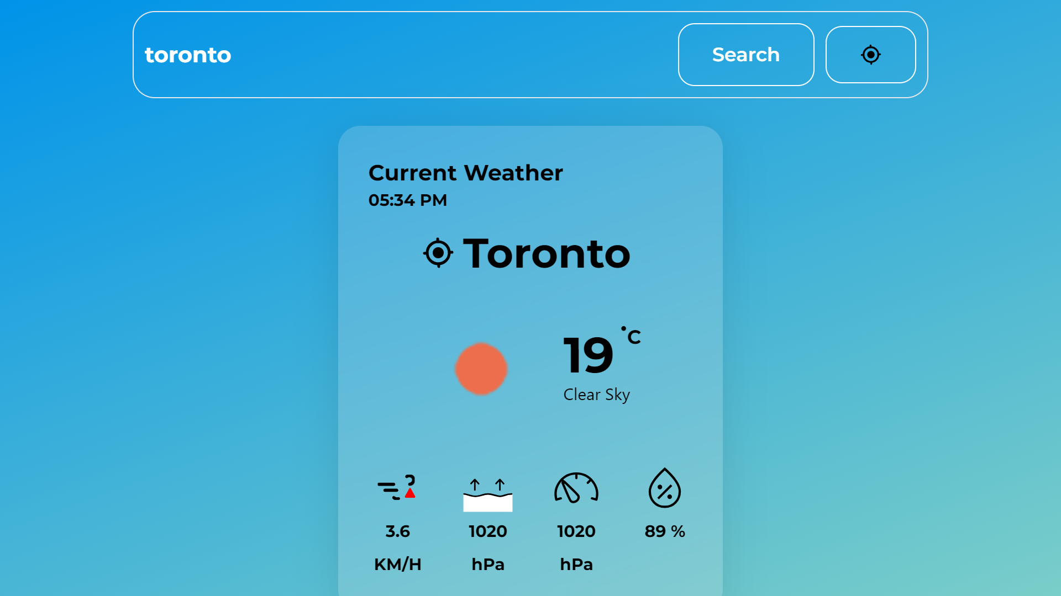
Expected Outcomes
Searched City Weather

Slide 34
Implementation & Testing
6.1 Implementation Platform / Environment
The weather application was developed using the MERN stack (MongoDB, Express.js, React.js, Node.js) to provide a full-stack solution. The front-end was built with React.js, styled using Tailwind CSS for a responsive user interface. Backend operations were handled by Node.js and Express.js for managing API requests and user data. The application also integrates the OpenWeatherMap API for fetching weather data and React Leaflet for mapping users’ locations.
6.2 Process / Program / Technology / Modules Specification(s)
- User Registration and Authentication:Managed through Node.js and JWT for secure login.
- Weather Data Retrieval:Integrated with OpenWeatherMap API to fetch real-time weather data and forecasts.
- Mapping: React Leaflet was used to display the user’s current location on a map along with relevant weather information.
- AI Integration:A generative AI component was integrated to provide future weather predictions along with precautions and recommendations based on user queries.
Technologies Used:
- Frontend: React.js, Tailwind CSS
- Backend: Node.js, Express.js, MongoDB
- APIs:OpenWeatherMap, React Leaflet

Slide 35
Implementation & Testing
6.3 Findings / Results / Outcomes
The system successfully meets the main objectives:
- Real-time weather data and forecasts are displayed for the registered city.
- The AI-based weather prediction feature works as intended.
- The user interface is responsive and intuitive, with real-time updates working smoothly.
- Integration of mapping for displaying current geographical location enhances the user experience.
Overall, the app operates efficiently in both desktop and mobile environments.
6.4 Result Analysis / Comparison / Deliberations
The implementation was evaluated by comparing the expected outcomes with actual results:
- Accuracy of weather data:The app consistently provides accurate real-time weather information from the OpenWeatherMap API.
- Performance:The app performs well in retrieving and displaying weather data without noticeable delays.
- AI predictions:The AI-generated future weather predictions were tested and successfully provide relevant suggestions.
- User Experience:Positive feedback was received regarding the intuitive interface and ease of navigation.
There were no major discrepancies between expected and actual outcomes, indicating the application meets the project's requirements effectively.

Slide 36
Implementation & Testing
6.5 Testing Plan / Strategy
A comprehensive testing strategy was adopted, focusing on unit testing, integration testing, and user acceptance testing:
- Unit Testing: Each component, including the login, registration, weather data fetching, and map display modules, was tested individually for functionality.
- Integration Testing: Verified seamless interaction between the frontend, backend, and third-party APIs.
- User Testing: Conducted with a sample of users to gather feedback on functionality and usability, particularly for the AI prediction feature and real-time updates.
Testing tools such as Postman was utilized for API testing.
6.6 Test Results and Analysis
The testing phase produced favorable results, with most test cases passing as expected. The real-time updates, data accuracy, and AI integration performed as designed. Minor issues such as slight delays in API responses during peak usage were identified and optimized.

Slide 37
Implementation & Testing
6.6.1 Test Cases (Test ID, Test Condition, Expected Output, Actual Output, Remark)
Test Case 1: User Registration
-Test Condition: A new user completes the registration form.
-Actual Output: User account is created successfully.
-Remark:Registration works as expected.
Test Case 2: Display Weather for Registered City
- Test Condition:User logs in and views weather for their registered city.
- Actual Output: Weather data is displayed correctly.
- Remark: Functionality works as expected.
Test Case 3: Search for Weather in Other City
- Test Condition: User searches for weather data in another city.
- Actual Output: Data is displayed accurately.
- Remark: Search functionality works as expected.
Test Case 4: View 7-Day Forecast
- Test Condition:User views the 5-day weather forecast.
- Actual Output: Forecast displayed correctly.
- Remark: Forecast feature works as expected.
Test Case 5: Display Current Location on Map
- Test Condition:User’s current geographical location is displayed on the map.
- Actual Output:Location is displayed accurately.
- Remark:Map integration works as expected.

Slide 38
Conclusion and Future Enhancements
7.1 Overall Analysis of Internship / Project Viabilities:
The project successfully achieved its objectives of developing a weather application with real-time data, city-based weather forecasts, mapping features, and AI-generated future predictions. The use of the MERN stack provided a solid framework for building a scalable, responsive web application. The integration of third-party APIs and the AI component was handled efficiently, making the project viable for real-world usage.
7.2 Problem Encountered and Possible Solutions:
API Response Delays: During high-traffic periods, weather data retrieval experienced slight delays. This was addressed by implementing data caching to reduce repeated API calls.
Map Integration Issues: Initial challenges with rendering the map based on the user's location were resolved by improving error handling and testing across different devices.
AI Prediction Accuracy: The AI model sometimes generated irrelevant suggestions, which was improved by fine-tuning the model and adjusting input parameters.
7.3 Summary of Internship / Project work
The project involved full-stack web development using modern technologies like React, Node.js, MongoDB, and third-party integrations like OpenWeatherMap and React Leaflet. The application enables users to view real-time weather for their registered city, search for any city’s weather, view 7-day forecasts, and get AI-generated weather insights. The internship/project provided valuable experience in both frontend and backend development, API integration, and user-centric design.

Slide 39
Conclusion and Future Enhancements
7.4 Limitations
Limited AI Accuracy: While the AI predictions offer future weather insights, the accuracy depends on available historical data and is subject to improvement.
Real-Time Updates: The app relies on third-party APIs for weather data, which may lead to occasional delays in providing real-time updates during high API usage periods.
Customization: The app currently offers limited customization for user alerts and preferences.
7.5 Future Enhancement
Personalized Weather Alerts: Allow users to set customized alerts based on temperature, humidity, or severe weather conditions.
Enhanced AI Predictions: Improve the AI model by incorporating more robust machine learning techniques and a wider dataset for better future weather predictions.
Multi-Language Support: Add support for multiple languages to reach a broader audience.
Mobile App Version: Extend the functionality to mobile platforms by developing iOS and Android versions of the app for greater accessibility and convenience

Slide 40
References
[1] OpenWeather, "API," OpenWeatherMap, 2024. [Online]. Available: https://openweathermap.org/api. [Accessed: 29-Nov-2024].
[2] AccuWeather, "AccuWeather Forecast API," AccuWeather Developer Portal, 2024. [Online]. Available: https://developer.accuweather.com/accuweather-forecast-api/apis. [Accessed: 29-Nov-2024].
[3] WeatherAPI, "API Documentation," WeatherAPI, 2024. [Online]. Available: https://www.weatherapi.com/. [Accessed: 29-Nov-2024].
[4] Dribbble, "Weather Web App," Dribbble, 2024. [Online]. Available: https://dribbble.com/shots/22126121-Weather-Web-App. [Accessed: 29-Nov-2024].

Slide 41

.

